Slide 1
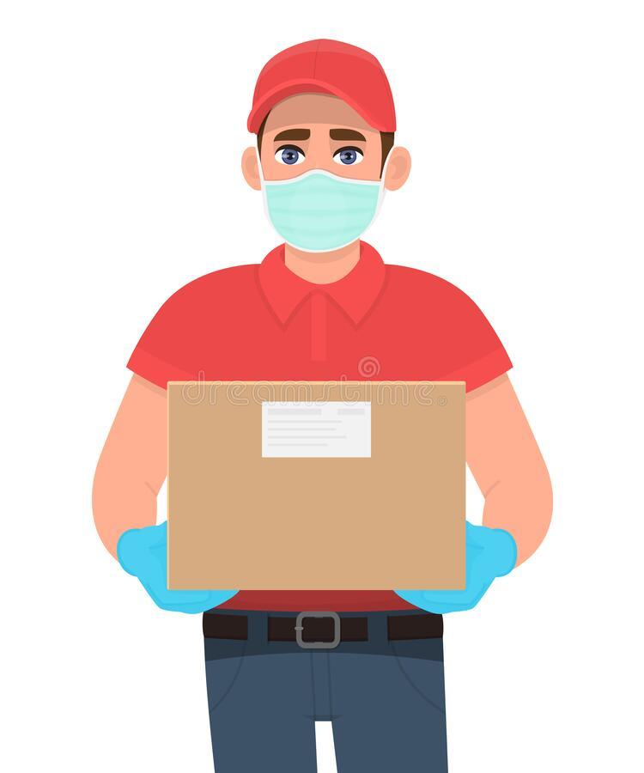
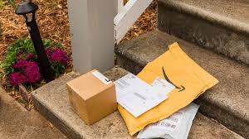
Have you ever…

Slide 2
Remote Gatekeeping System
Group 19
Pubudu Bandara E/17/027
Achintha Harshamal E/17/090
Ishara Sandakelum E/17/219

Slide 3
Solution
Mobile controlling interface
Smart Mailbox
Web interface
Control unit with intercom

Slide 4
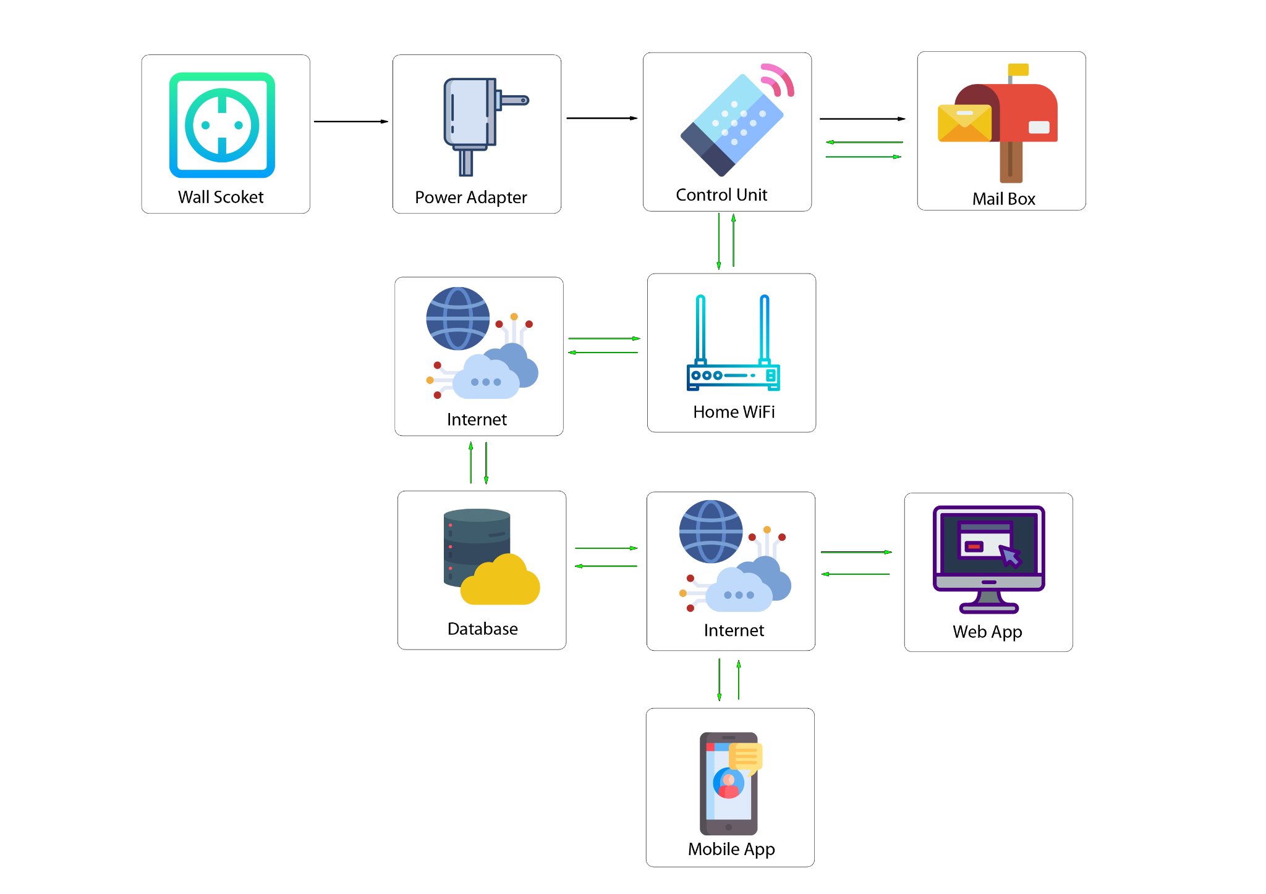
Overview of the System

Slide 5
Main Features of the System
Visual Identification of the outsider
Continuous Intercom communication
Secure mechanism to Remotely handle / store deliveries
Log of previous events : Mobile interface
Device and User Registration : Web Interface
Notes:
100 attempts / 1 hour / 1ip
Fine grain tuning
Refresh token is fetched after 3600 seconds therefore user do not have to login for different app restarts

Slide 6

Special Features
Resilient to Power Surges
Unique design to avoid delivery theft
Biometric login
Stores the current status on the memory
The system can safely resuscitate itself
Cannot access previous deliveries
The lid closes automatically / mechanically

Slide 7
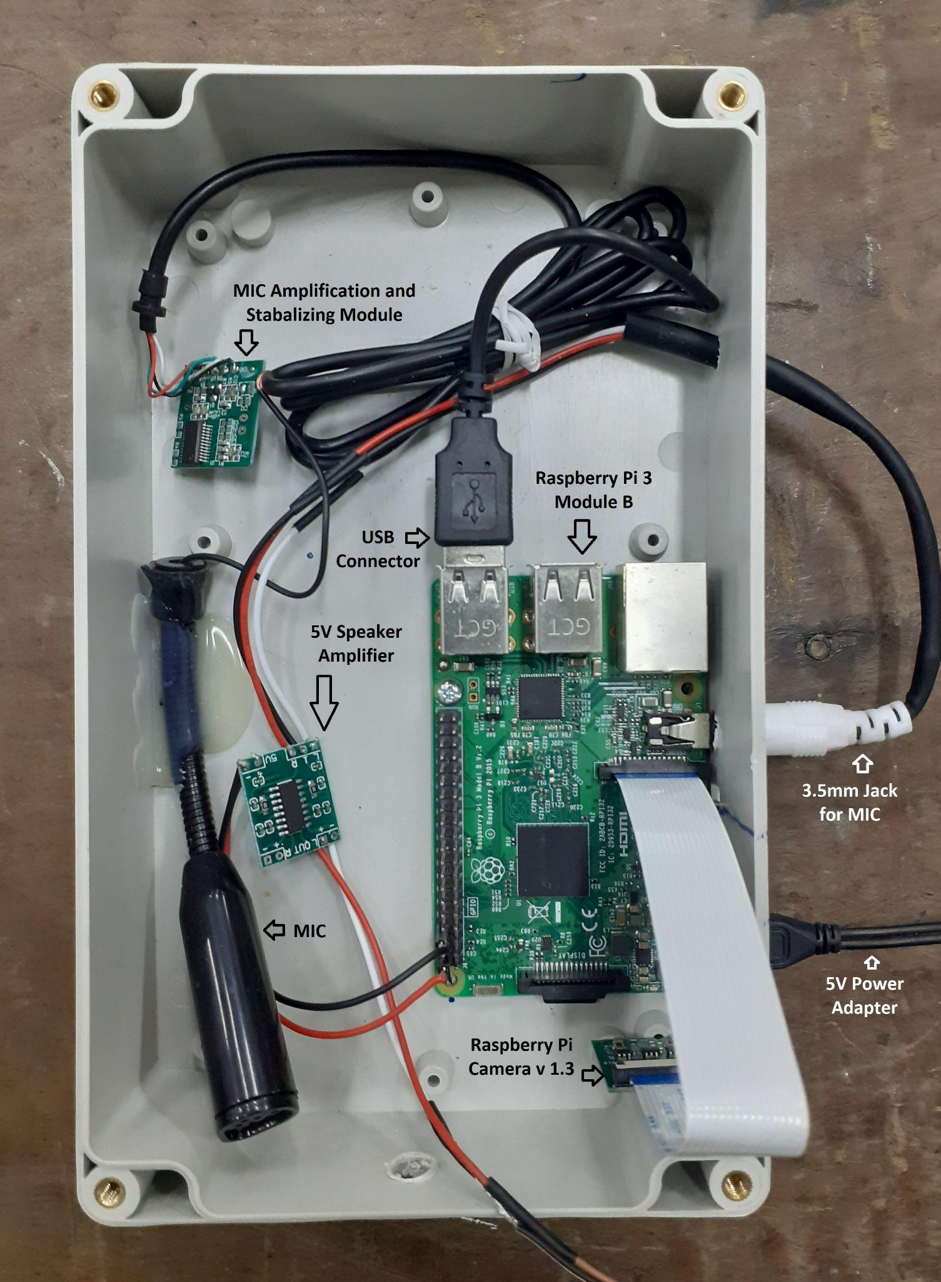
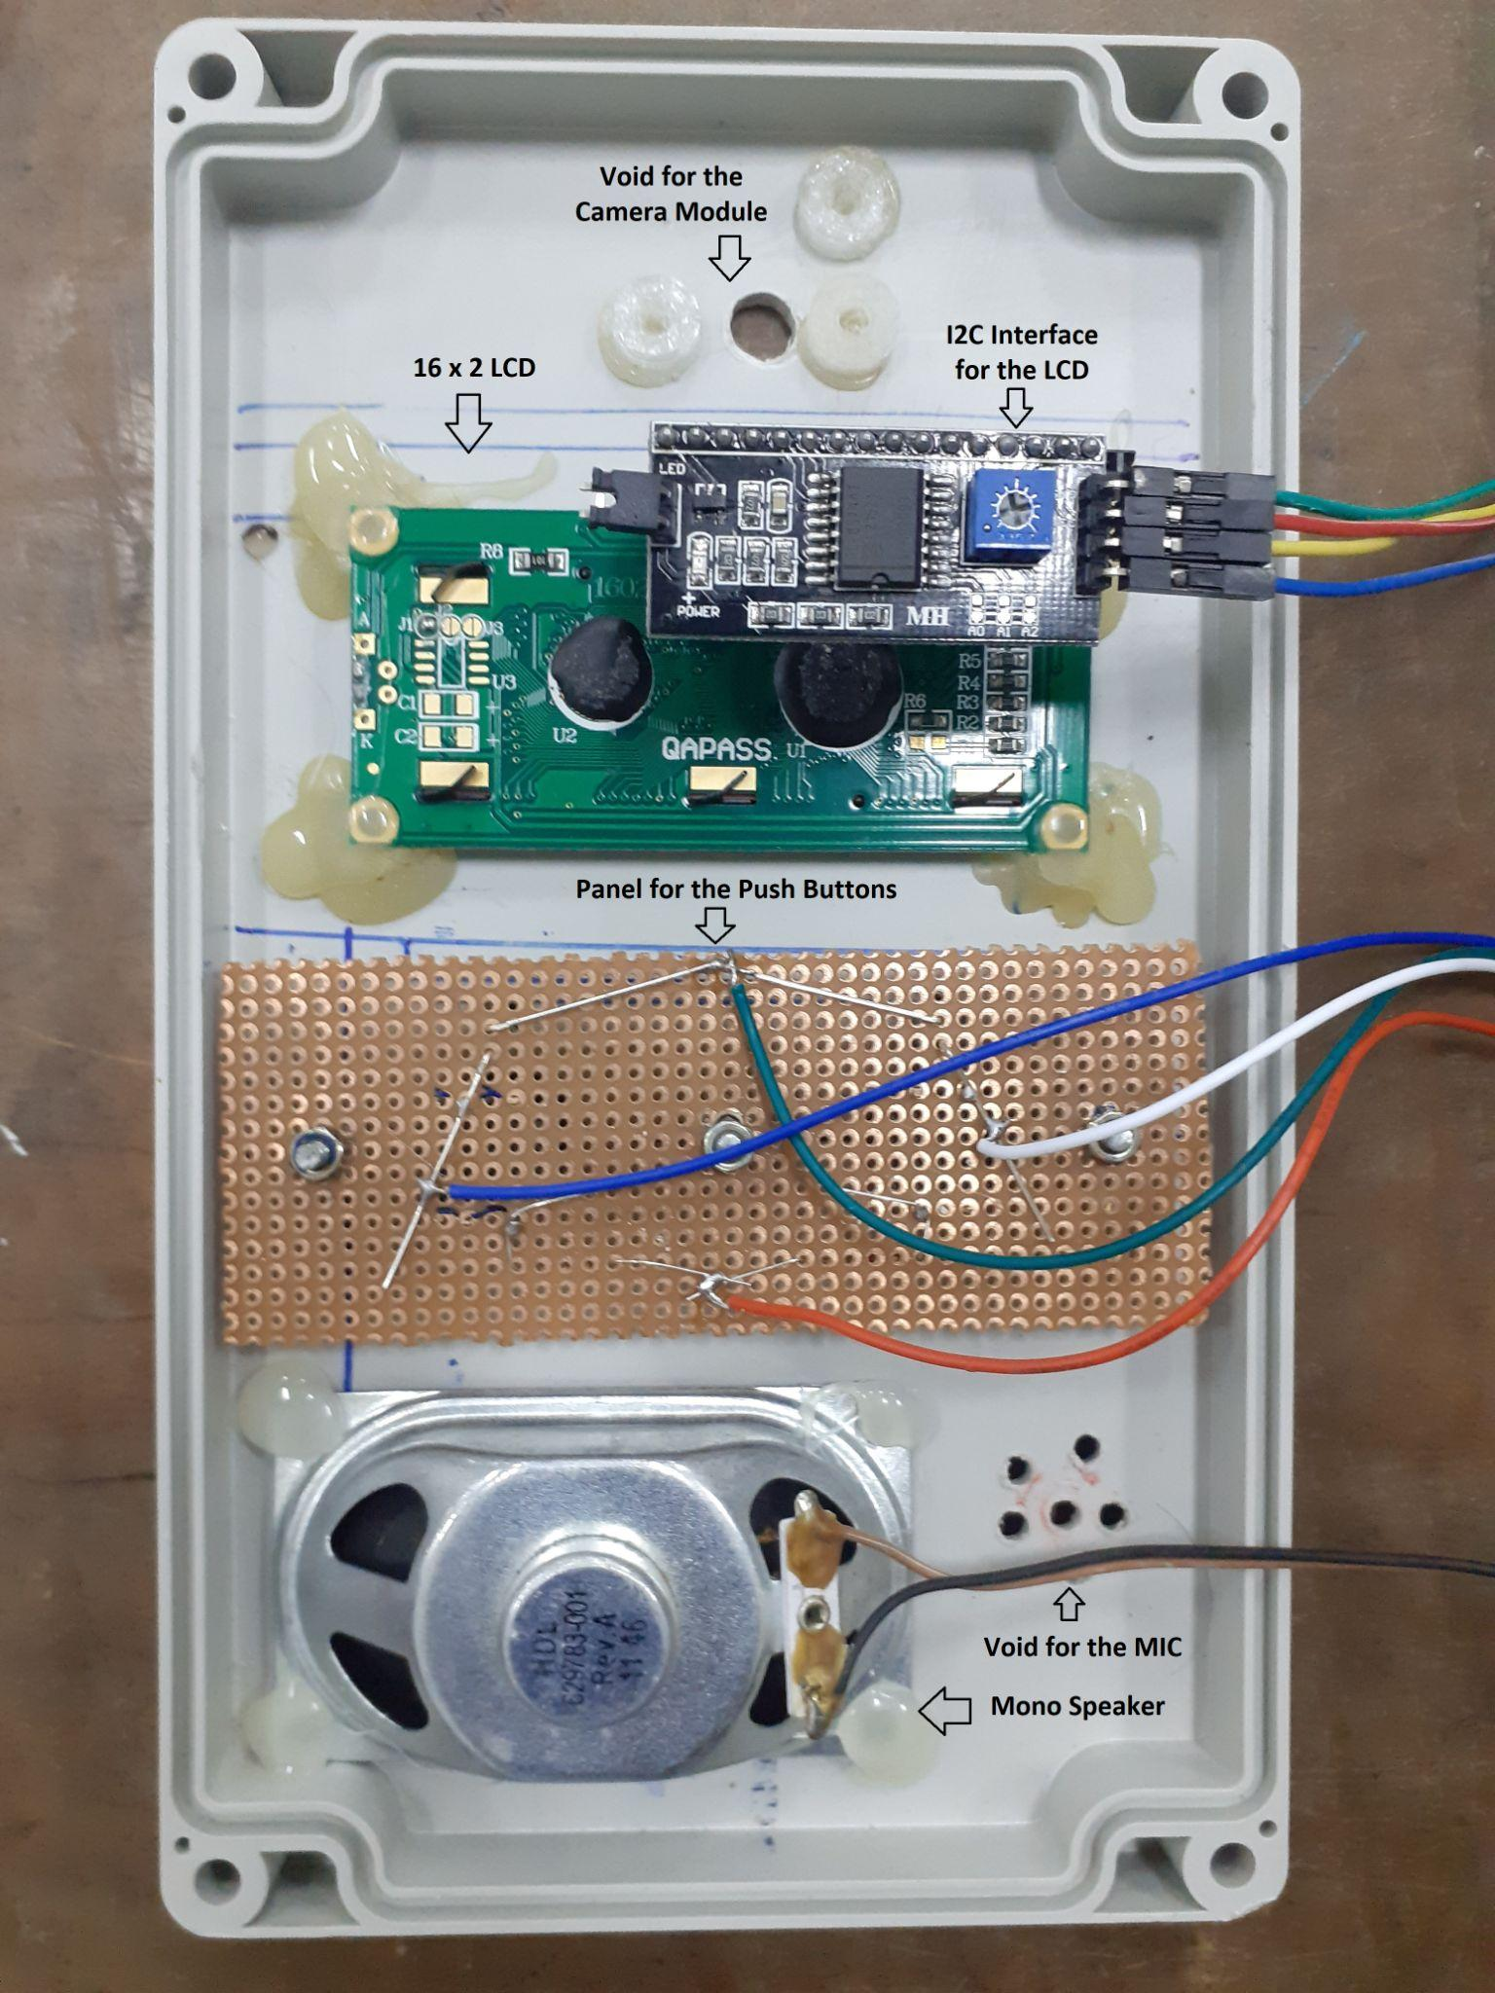

Slide 8
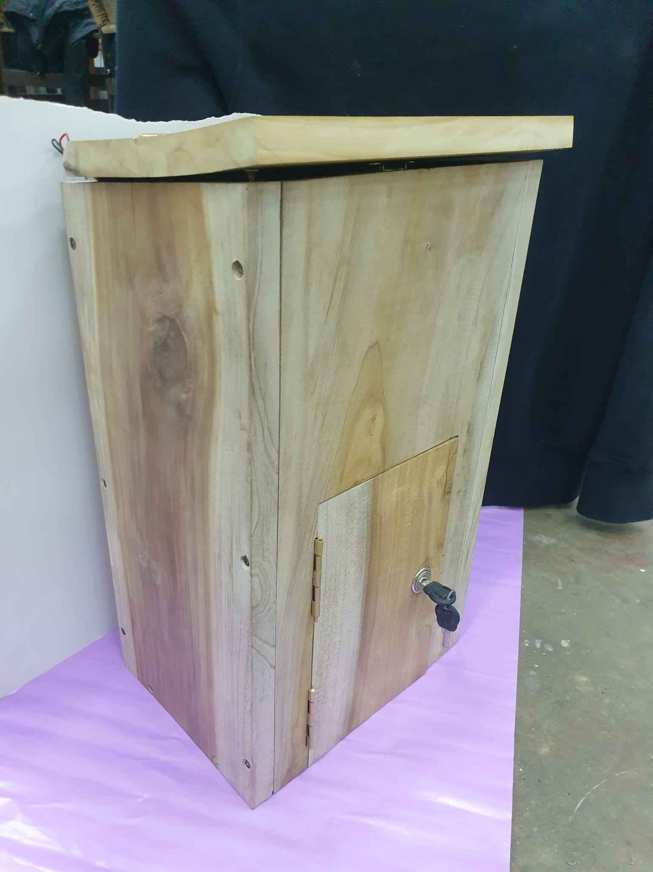
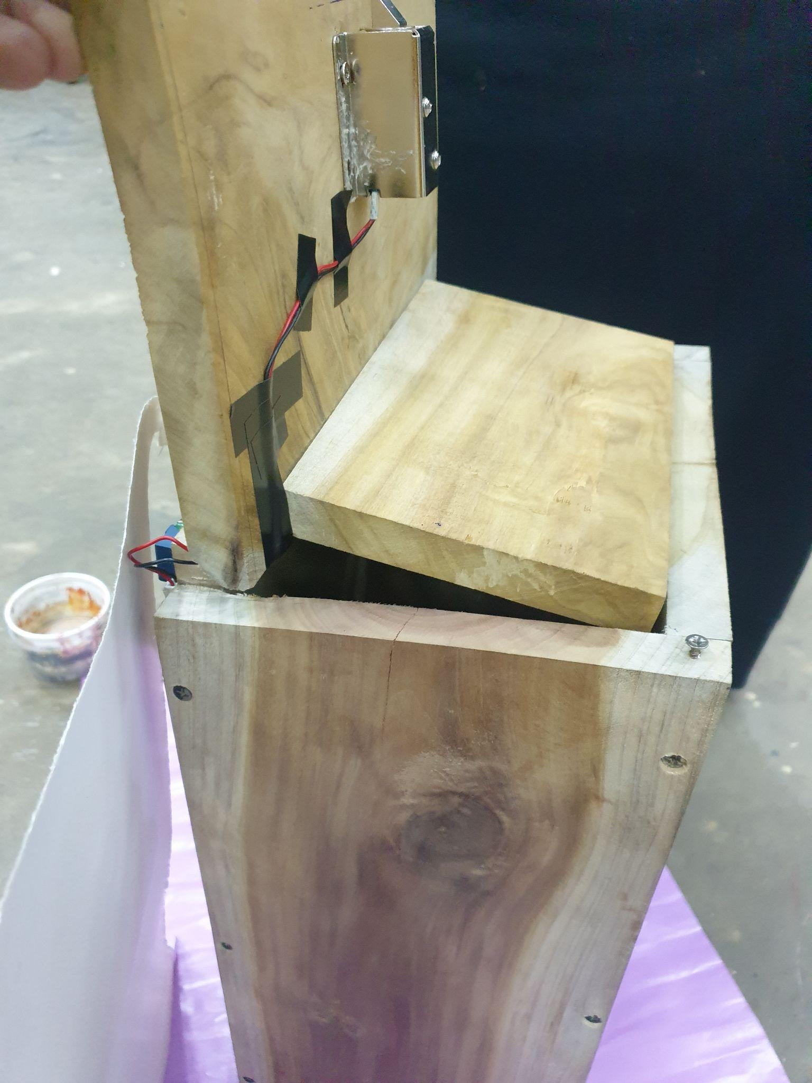

Slide 9

UI and UX
Mobile Application
Web Application
Hardware Module
User manual
Notes:
pyrebase

Slide 10
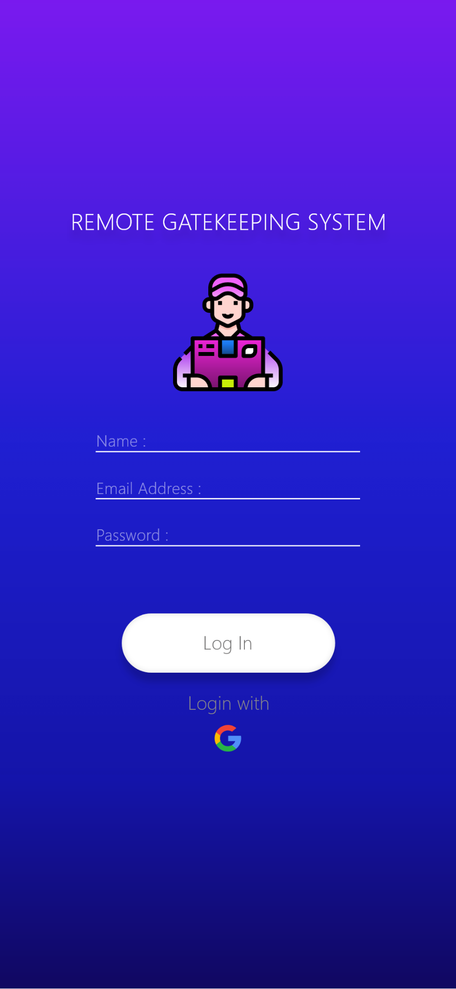
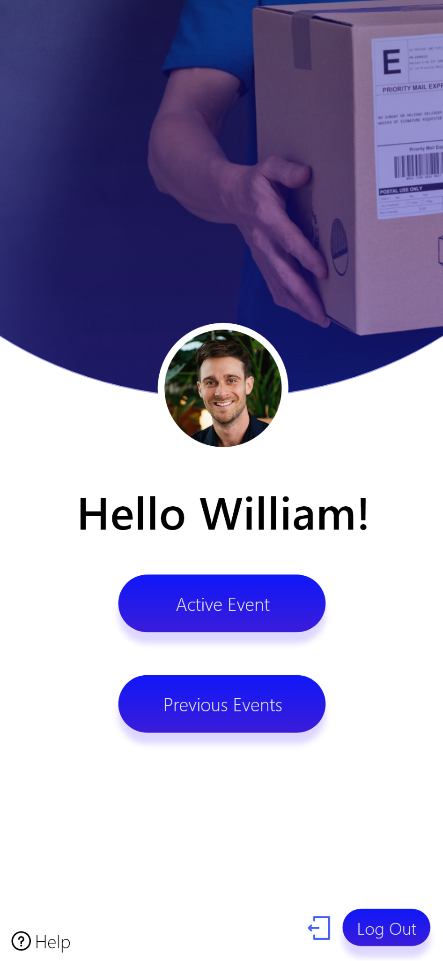
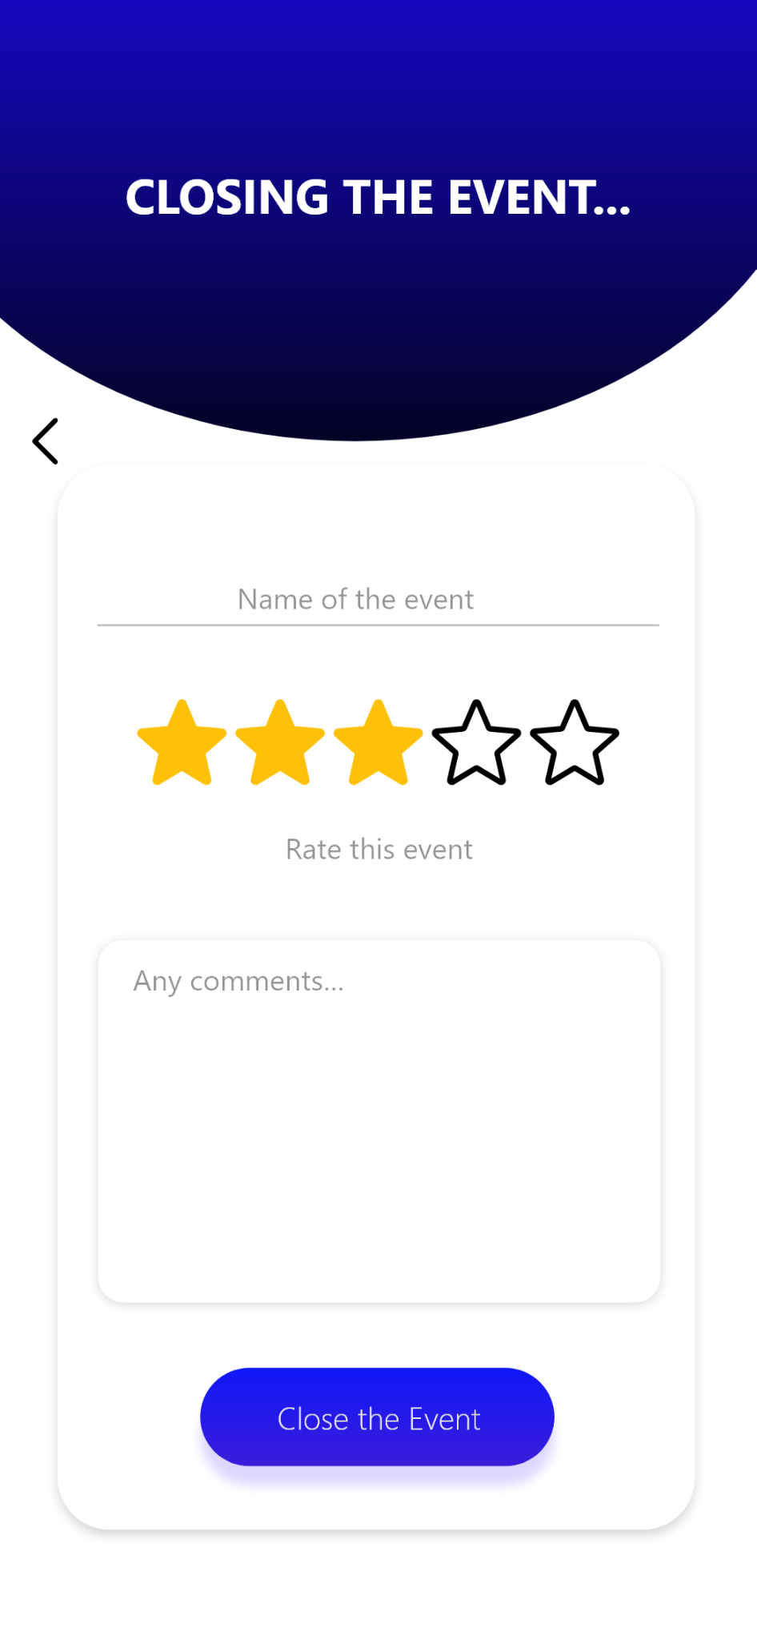
Mobile Application
Easy Navigation system
Biometrics for account log-in
Realtime updates
Modern features like : pull to refresh

Slide 11
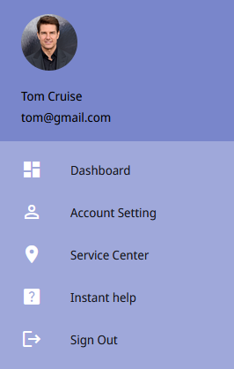
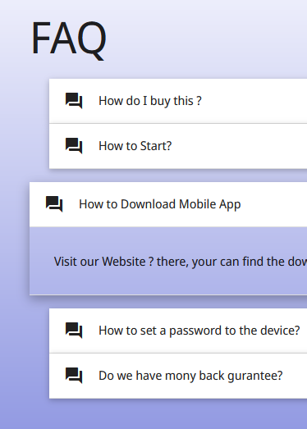
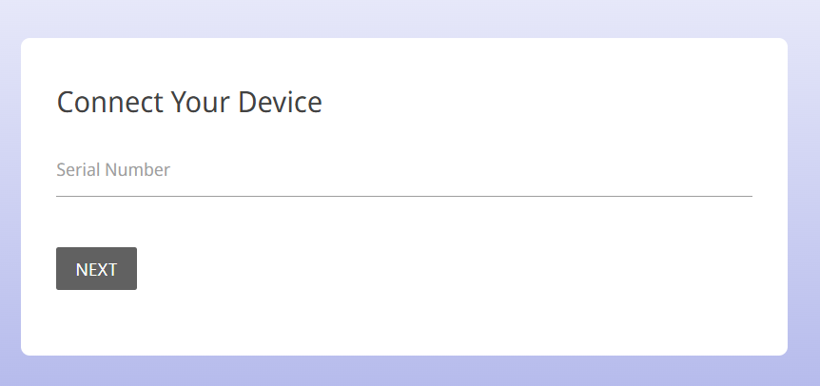
Web Application
Device Registration
Usage History
User Registration
Mobile Application Download
https://gate-keeper-6fad9.web.app/

Slide 12



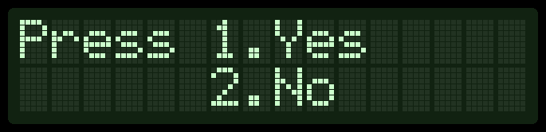
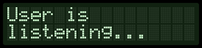



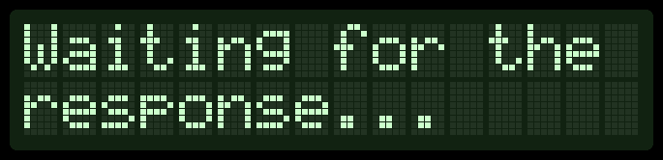

Outsider Interactions
User friendly navigation
Real Time updating
Interrupts handling with timeouts
Notes:
Hardware node output
User is kept updated throughout the event
...constantly updated
Instructions are easy to understand

Slide 13
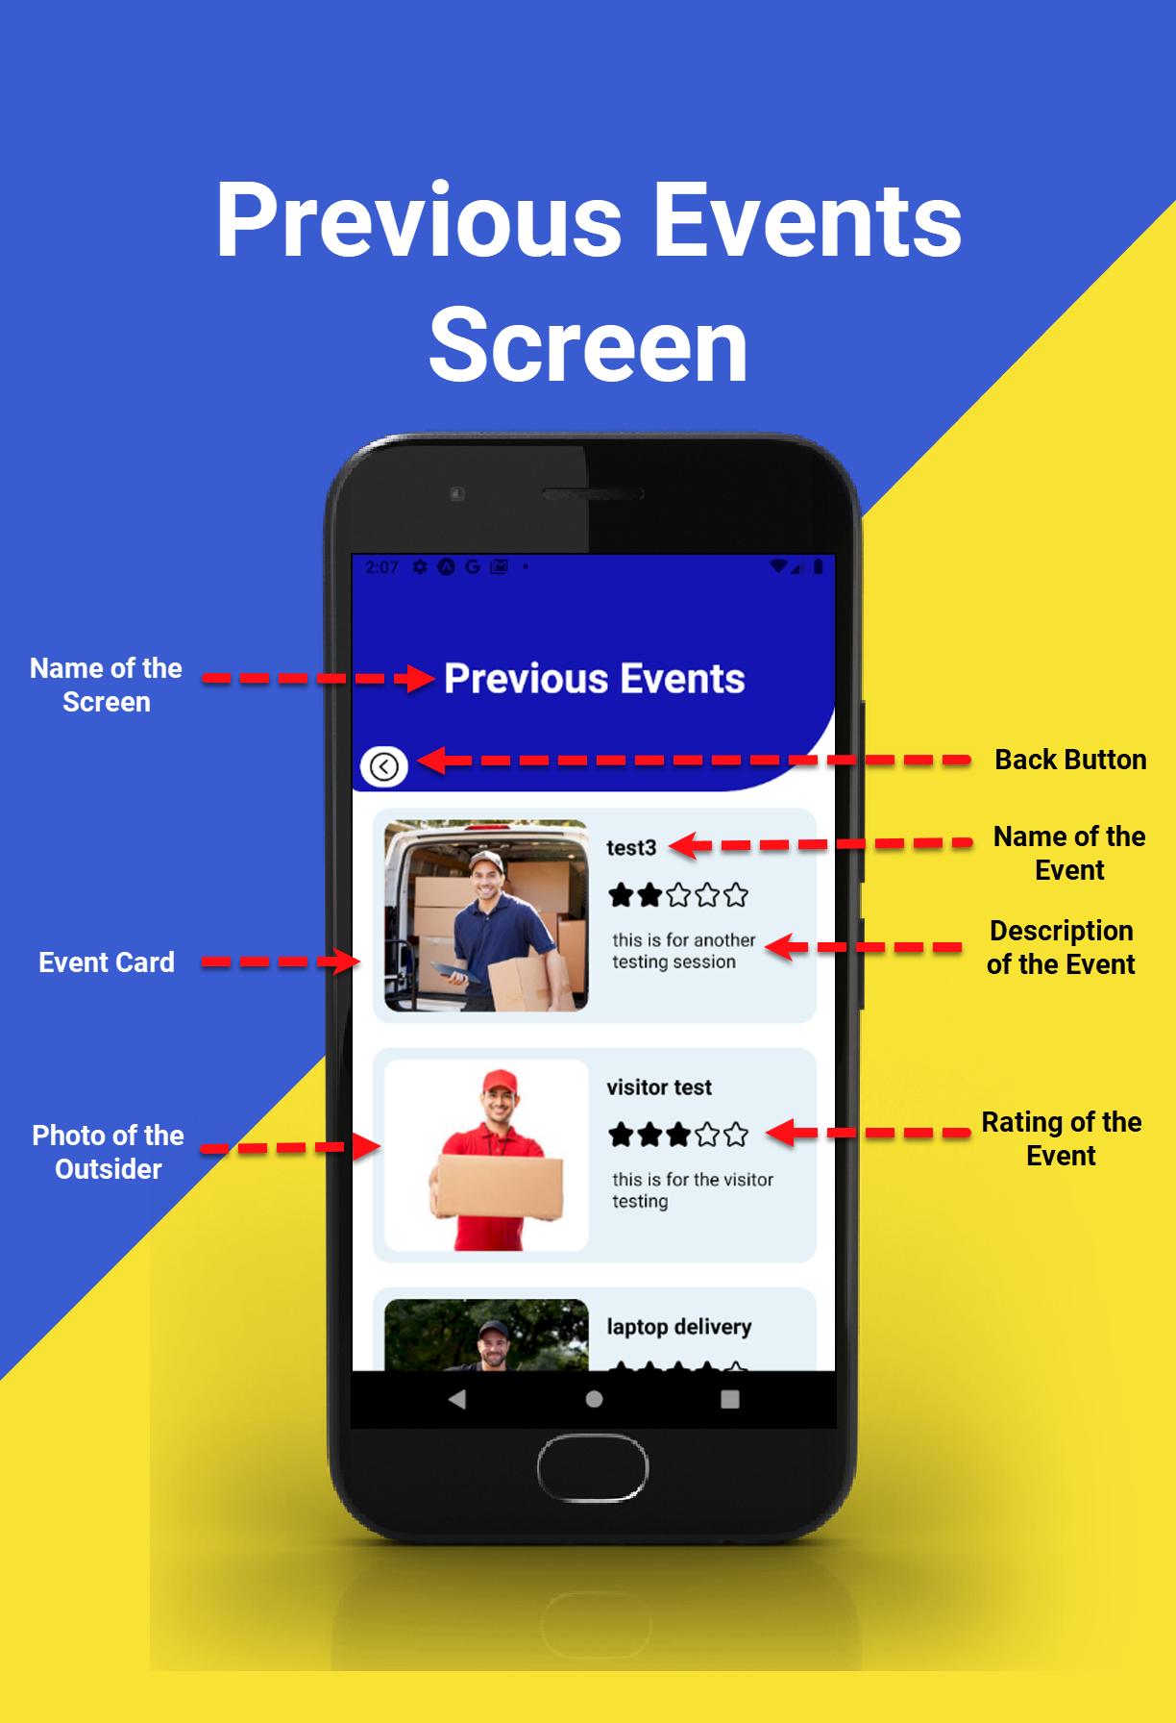
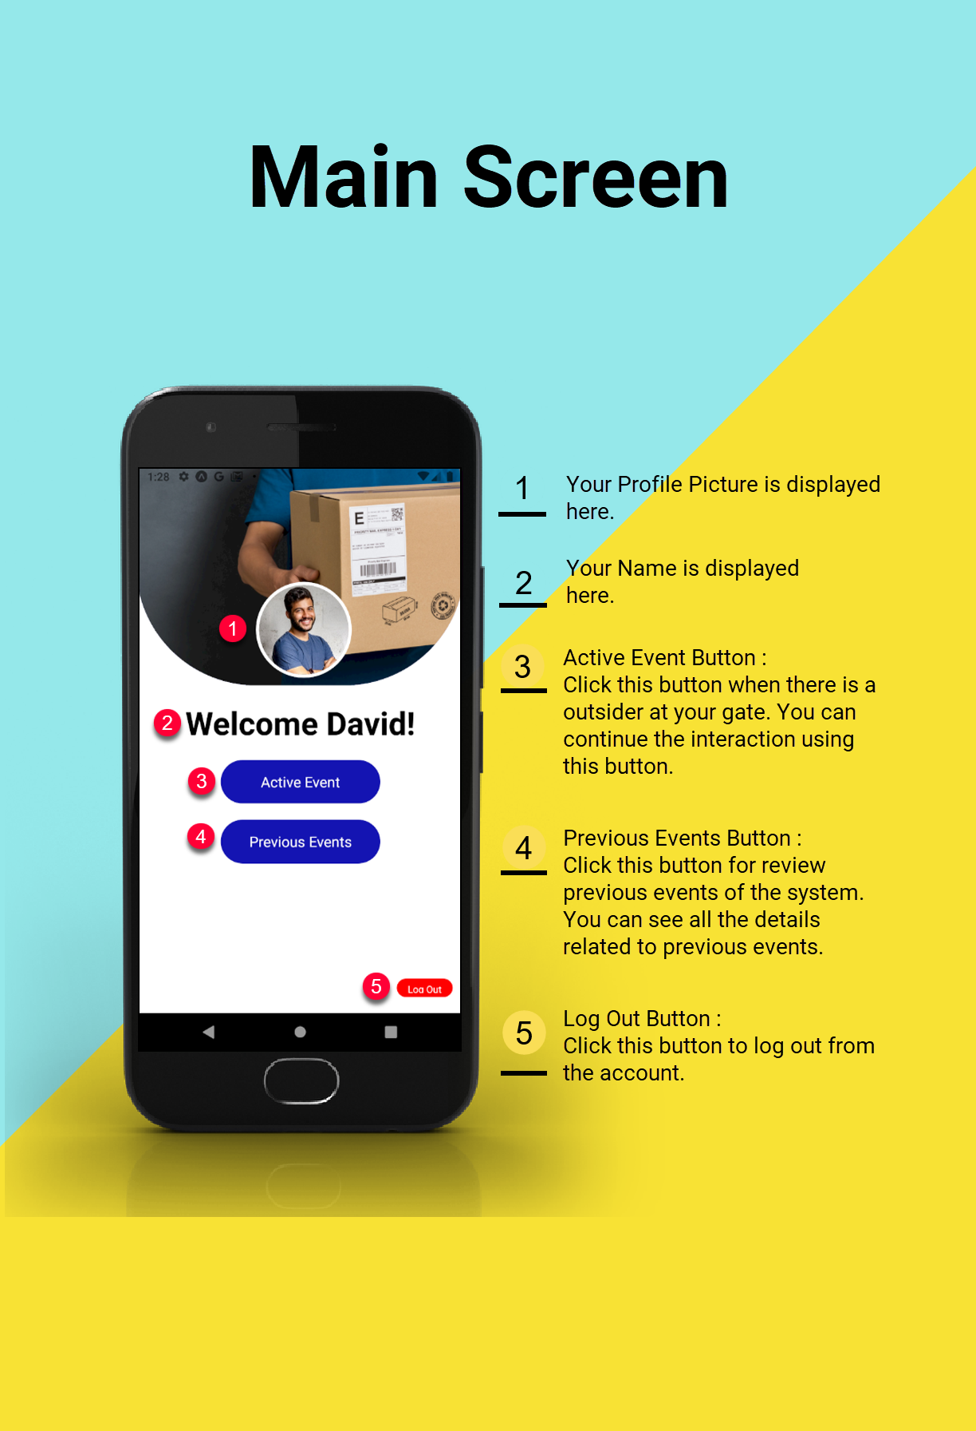
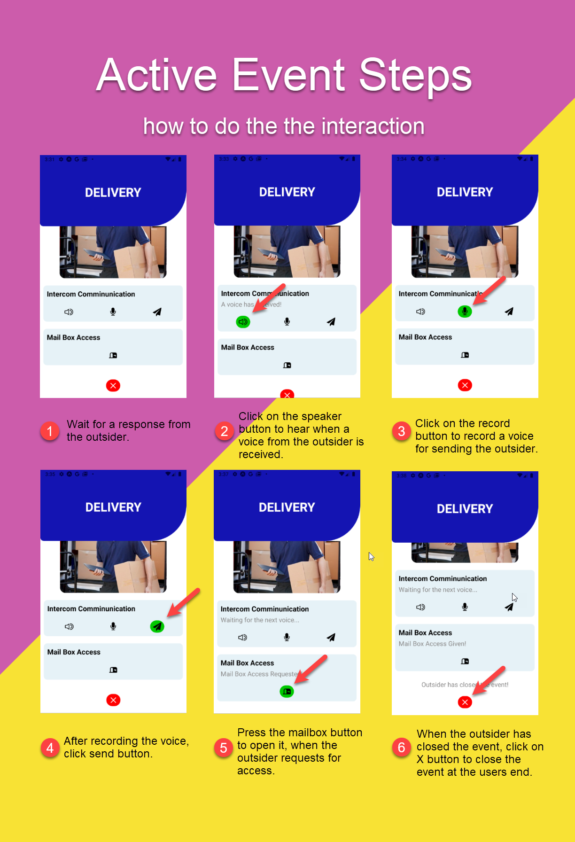
User Manual
Graphically nice-looking pages
Operating steps are clearly explained
Troubleshooting

Slide 14
Future Implementations
Facial Recognition to identify outsiders
Support for Video Streaming
An Integrated system to replace Raspberry Pi
Different types of Mailboxes, tailor-made for the customers
Notes:
100 attempts / 1 hour / 1ip
Fine grain tuning
Refresh token is fetched after 3600 seconds therefore user do not have to login for different app restarts

Slide 15

Demo
End-to-End

Slide 16
Thank You!
Questions…

